Slide 1

Spatial and storm-time dependence of electron microburst pitch angle anisotropy
Presented by Conrad Meyer-Reed

Slide 2
Outline:
Science & Mission Background
Statistical Year Study
Storm-time Epoch Analysis

Slide 3
Science Background

Slide 4
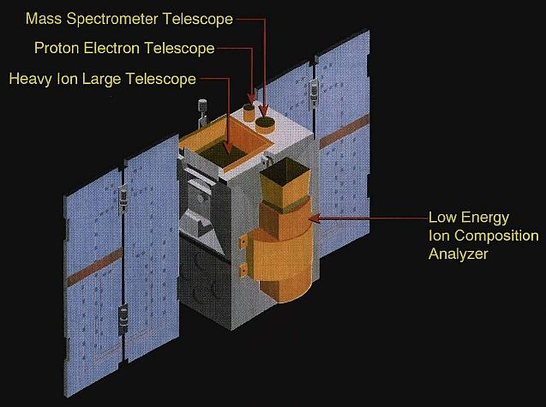
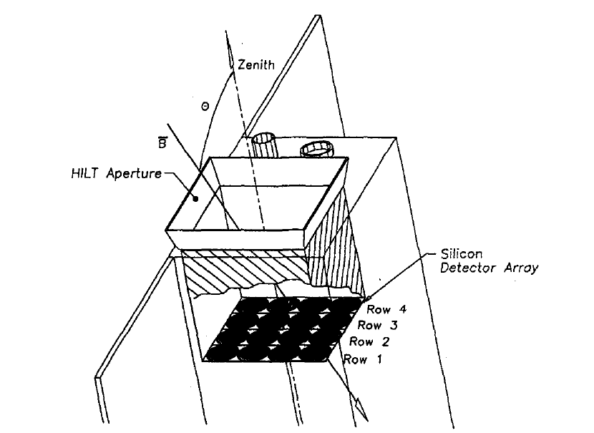
Mission Background
The Solar Anomalous and Magnetospheric Particle Explorer (SAMPEX) satellite collected information about particles in the Earth’s radiation belts in near polar orbit from 1992-2004
The Heavy Ion Large Telescope (HILT) instrument onboard the SAMPEX satellite consisted of 4x4 Silicon detector array that recorded >1 MeV electron counts in high latitude regions of the magnetosphere
(From eoPortal Directory)
When anisotropic populations of electrons are collected by the HILT instrument, the geometry of the detector rows will cause differences in the total electron counts detected across the array.
Conversely when isotropic populations of electrons are collected by the HILT instrument, the total electron counts detected will be similar across the array.
By taking the ratio of electron counts from Row 1 (SSD1) and Row 4 (SSD4) of the detectors, a measure of pitch angle isotropy can be determined, where:
Iso = 0 -> Anisotropic
Iso = 1 -> Isotropic
(From Blake et al, 1996)

Slide 5
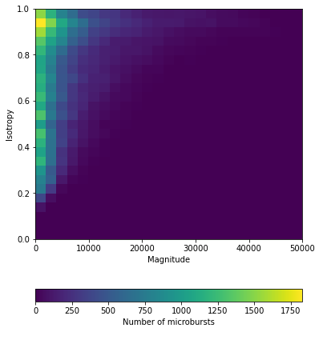
Statistical Year Study

Slide 6
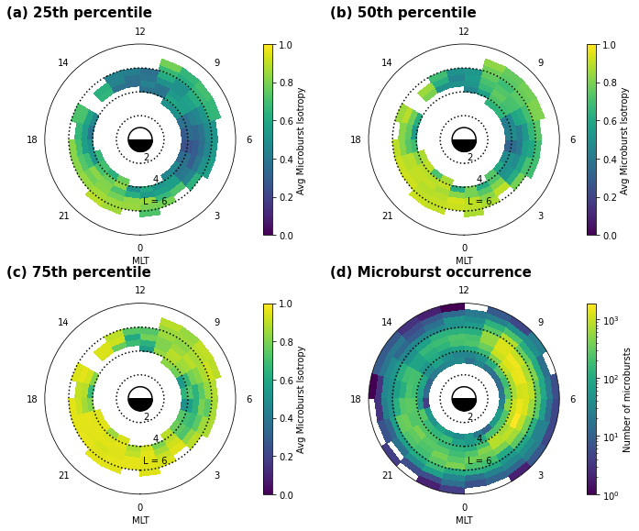
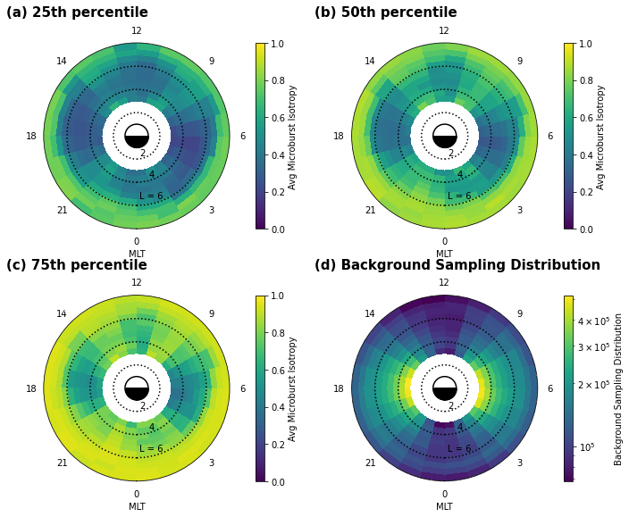
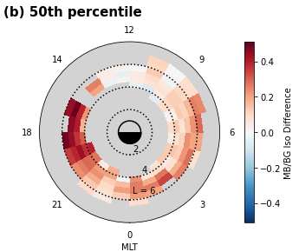
Statistical Year Study

Slide 7
Storm-time Epoch Analysis

